Slide 1
Compiler Design
23CS5PECPD – Unit 4
Prof. SNEHA S BAGALKOT
Assistant Professor, Dept. of CSE

Slide 2
UNIT – 4: Intermediate Code Generation
Intermediate Code Generation:
Variants of syntax trees,
Three-address code,
Types and declarations,
Translation of expressions,
Control flow,
Switch statements

Slide 3
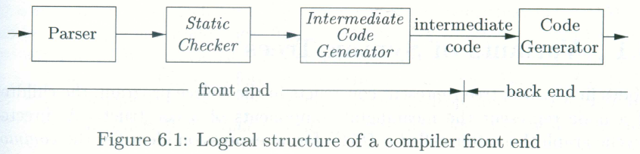
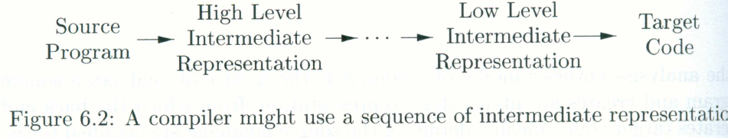
Intermediate Code Generation:
Intermediate-Code Generation

Slide 4
Variants of Syntax Trees
Nodes of syntax tree represent constructs in the source program; the children of a node represent the meaningful components of a construct.
A directed acyclic graph (DAG) for an expression identifies the common subexpressions of the expression.
Intermediate-Code Generation

Slide 5
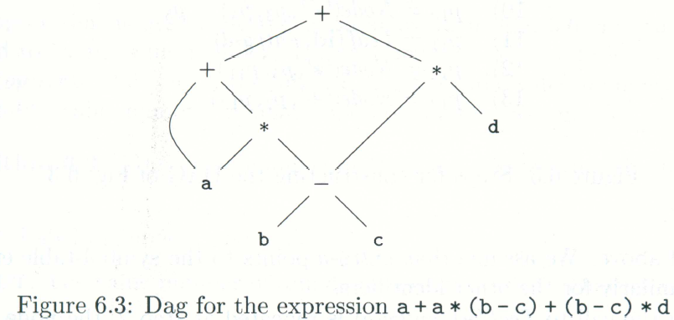
Directed Acyclic Graphs for Expressions
Intermediate-Code Generation

Slide 6
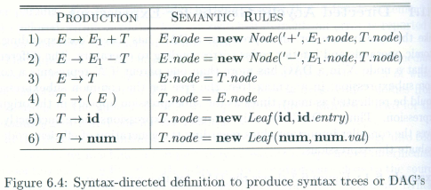
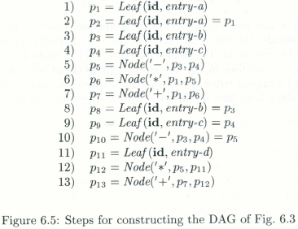
Directed Acyclic Graphs for Expressions
Intermediate-Code Generation

Slide 7
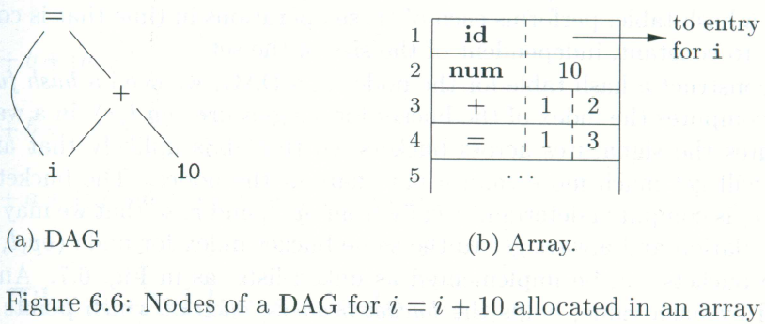
The Value-Number Method for Constructing DAG’s
Algorithm 6.3
Intermediate-Code Generation

Slide 8
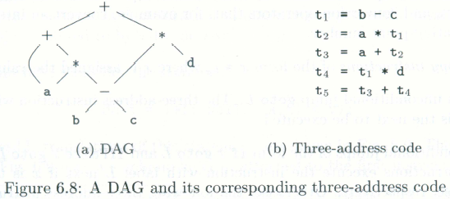
Three-Address Code
In three-address code, there is at most one operator on the right side of an instruction; that is, no built-up arithmetic expressions are permitted.
x+y*z ⇒ t₁ = y * z
t₂ = x + t₁
Example 6.4:
Intermediate-Code Generation

Slide 9
Address and Instructions
Three-address code is built from two concepts: addresses and instructions.
An address can be one of the following:
  A name
  A constant
  A compiler-generated temporary
Intermediate-Code Generation

Slide 10
Address and Instructions
A list of common three-address instruction forms:
  Assignment instructions of the form x = y op z
  Assignments of the for x = op y
  Copy instructions of the form x = y
  An unconditional jump goto L.
  Conditional jumps of the form if x goto L and ifFalse x goto L
  Conditional jumps such as if x relop y goto L
  Procedure calls and returns
  Indexed copy instructions of the form x=y[i] and x[i]=y
  Address and pointer assignments of the form x = &y, x = *y, and *x = y
Intermediate-Code Generation

Slide 11
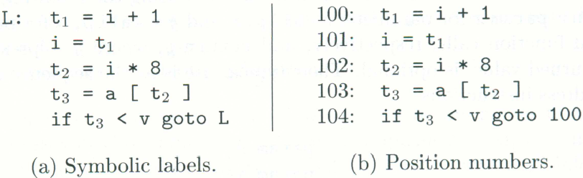
Address and Instructions
Example 6.5:
  do i = i +1; while (a[i]<v);
Intermediate-Code Generation

Slide 12
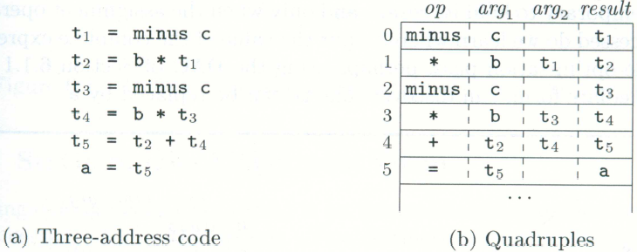
Quadruples
Three-address instructions can be implemented as objects or as record with fields for the operator and operands.
Three such representations
  Quadruple, triples, and indirect triples
A quadruple (or quad) has four fields: op, arg₁, arg₂, and result.
Example 6.6:
Intermediate-Code Generation

Slide 13
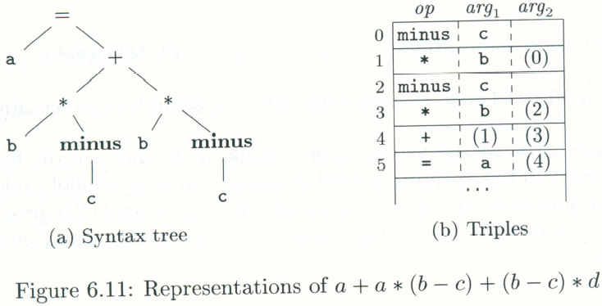
Triples
A triple has only three fields: op, arg₁, and arg₂
Using triples, we refer to the result of an operation x op y by its position, rather by an explicit temporary name.
Example 6.7:
Intermediate-Code Generation

Slide 14
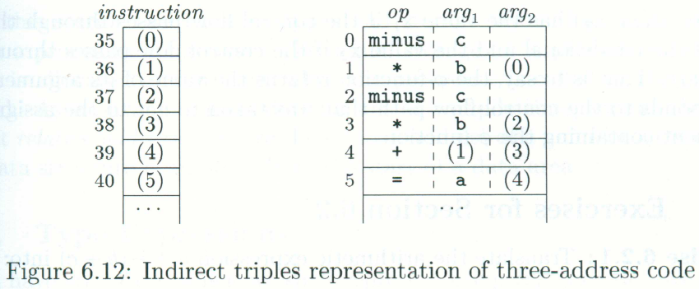
Triples
Intermediate-Code Generation

Slide 15
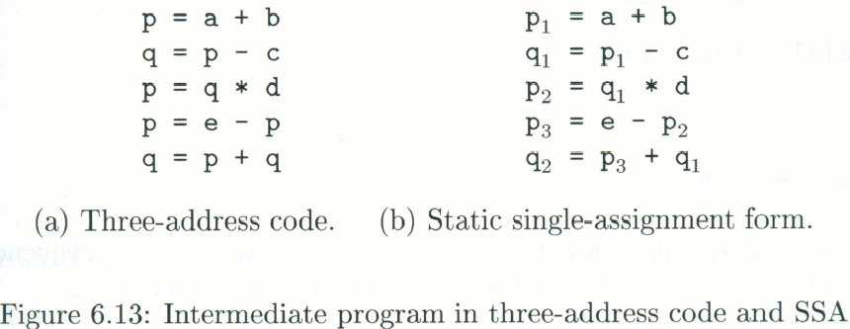
Static Single-Assignment Form
Static single assignment form (SSA) is an intermediate representation that facilitates certain code optimization.
Two distinct aspects distinguish SSA from three –address code.
  All assignments in SSA are to variables with distinct names; hence the term static single-assignment.
Intermediate-Code Generation

Slide 16
Static Single-Assignment Form
if (flag) x = -1; else x = 1;
y = x * ;a
if (flag) x₁ = -1; else x₂ = 1;
X₃ = φ(x₁, x₂)
Intermediate-Code Generation

Slide 17
Types and Declarations
The applications of types can be grouped under checking and translation:
  Type checking uses logical rules to reason about the behavior of a program at run time. Specifically it ensures that the types of the operands match the type expected by an operator.
  Translation Applications. From the type of a name, a compiler can determine the storage that will be needed for the name at run time.
    Type information is also needed to calculate the address denoted by an array reference, to insert explicit type conversions, and to choose the right version of an arithmetic operator, among other things.
In this section, we examine types and storage layout for names declared within a procedure or a class.
Intermediate-Code Generation

Slide 18
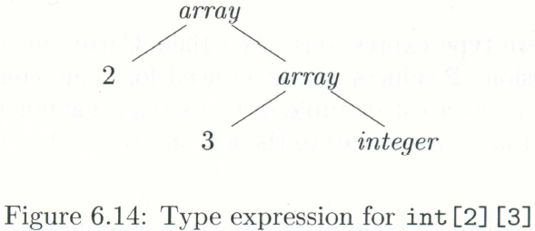
Type Expressions
Types have structure, which we shall represent using type expressions:
  A type expression is either a basic type or is formed by applying an operator called a type constructor or to a type expression
Example 6.8:
  int[2][3]
    “array of 2 arrays of 3 integers each”
    array(2, array(3, integer))
Intermediate-Code Generation

Slide 19
Type Expressions
Definition of type expressions:
  A basic type is a type expression.
  A type name is a type expression.
  A type expression can be formed by applying the array type constructor to a number and a type expression.
  A record is a data structure with named fields.
  A type expression can be formed by using the type constructor → for function type.
  If s and t are type expressions, then their Cartesian product s×t is a type expression.
  Type expressions may contain variables whose values are type expressions.
Intermediate-Code Generation

Slide 20
Type Equivalence
When type expressions are represented by graphs, two types are structurally equivalent if and only if one of the following condition is true:
  They are the same basic type.
  They are formed by applying the same constructor to structurally equivalent types.
  One is a type name that denotes the other.
Intermediate-Code Generation

Slide 21
Declaration
We shall study types and declarations using a simplified grammar that declares just one name at a time.
D → T id; D | ε
T → B C | record ‘{‘ D ‘}’
B → int | float
C → ε | [num] C
Intermediate-Code Generation

Slide 22
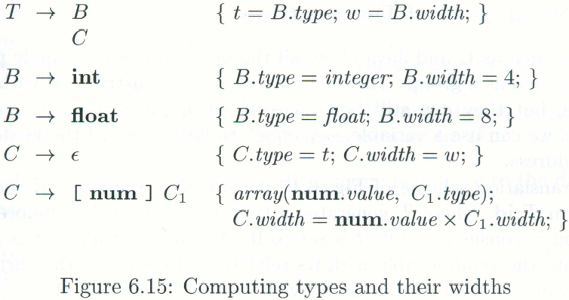
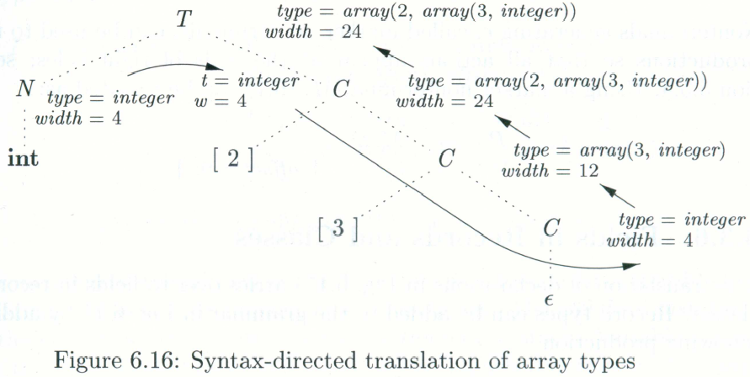
Declaration
Example 6.9:
Intermediate-Code Generation

Slide 23
Translation of Expressions
An expression with more than one operator, like a+b*c, will translate into instructions with at most one operator per instruction.
An array reference A[i][j] will expand into a sequence of three-address instructions that calculate an address for the refernce.
Intermediate-Code Generation

Slide 24
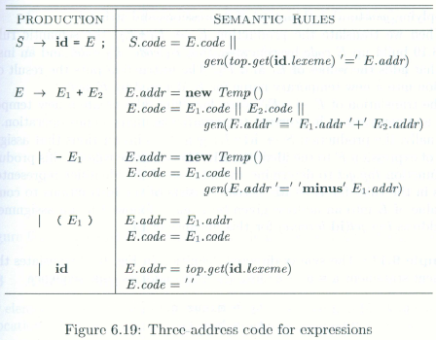
Operations Within Expressions
Example 6.11:
  a = b+ -c
  t1 = minus c
  t2 = b + t1
  a = t2
Intermediate-Code Generation

Slide 25
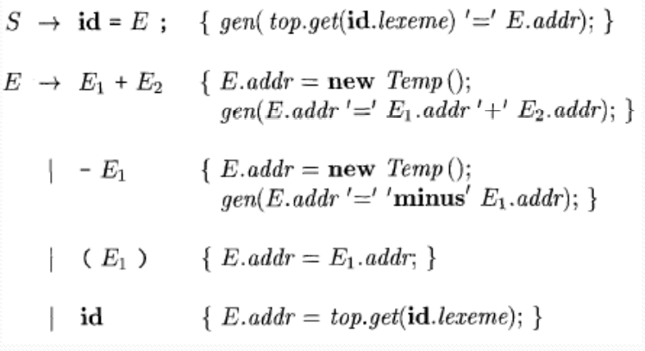
Incremental Translation
Generating three-address code for expressions incrementally
E -> E1 + E2 { E.addr = new Node(‘+’, E1.addr, E2.addr); }

Slide 26
Addressing Array Elements
Array elements are accessed by storing them in a block of consecutive locations.
Eg: Array A[n] => Index 0, 1, …. n-1
If width of each array element is w, base is the relative address of A[0], then the ith element of array A begins in location base + i x w
In 2D array, A[ ][ ], let w1 be width of a row and w2 be width of an element in a row, the relative address of A[i1][i2] is
base + i1 x w1 + i2 x w2
In k dimensions, the formula is
base + i1 x w1 + i2 x w2 + …….. + ik x wk

Slide 27
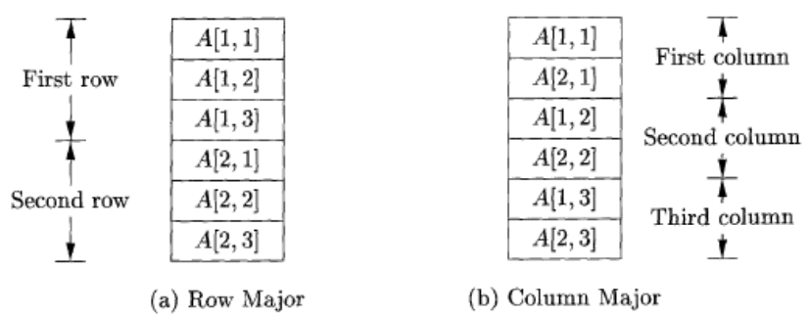
Addressing Array Elements
Layouts for a two-dimensional array:

Slide 28
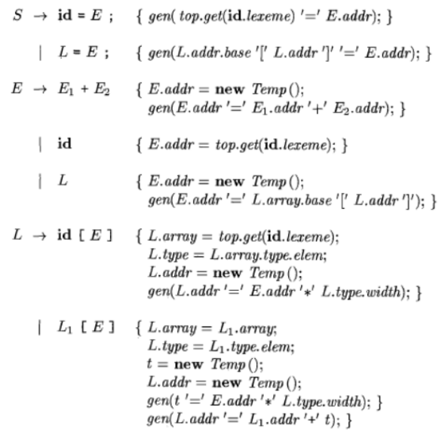
Translation of Array References
L -> L [ E ] | id [ E ]

Slide 29
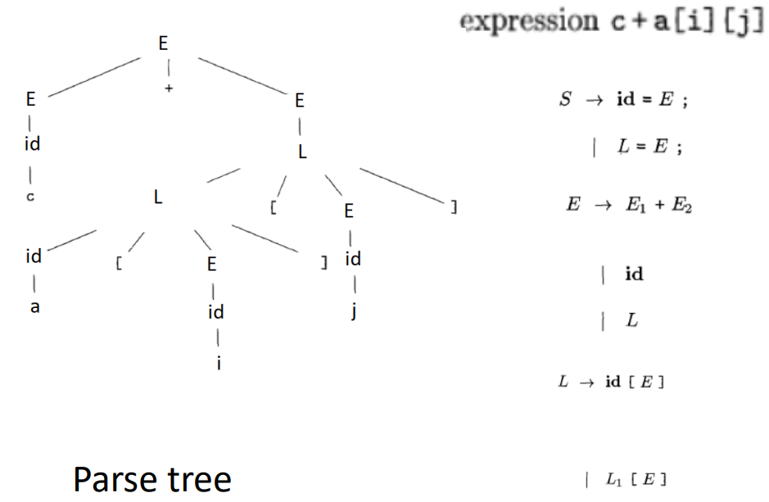
Translation of Array References Example

Slide 30

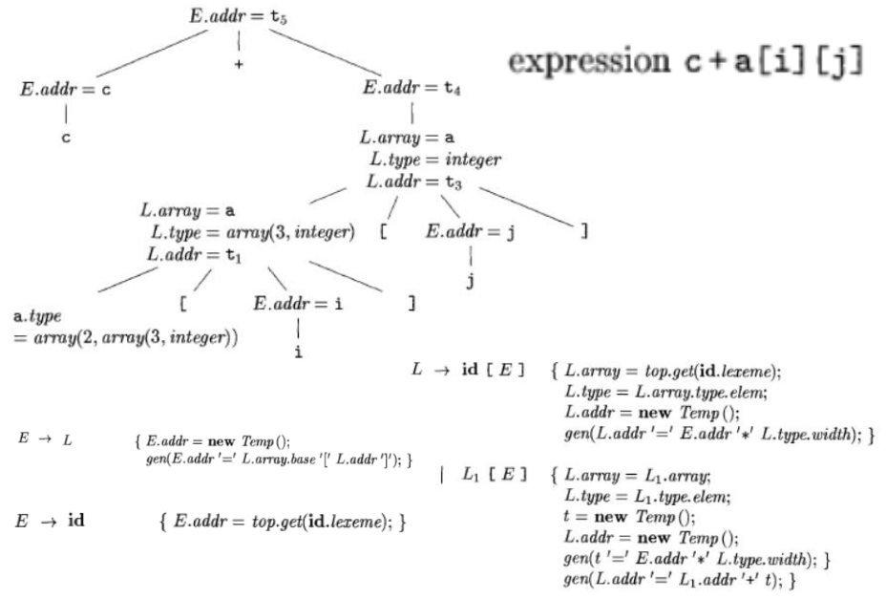

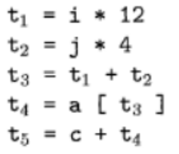
Translation of Array References Example
Array total width =24 [4 bytes * 6 elements]
w1=12, w2=12
Three-address code for expression c + a[i][j]
Annotated parse tree for c + a[i][j]

Slide 31
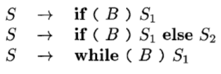
Control flow
Translation of statements such as if-else-statements and while statements
Key step: Translation of boolean expressions
Boolean expressions are used as
(i) Conditional expressions in statements that alter the flow of control
(ii) A boolean expression can evaluate true Or false as values. Such boolean expressions can be evaluated in analogy to arithmetic expressions using three-address instructions with logical operators
The intended use of boolean expressions is determined by its syntactic context.
We concentrate on the use of boolean expressions to alter the flow of control.
For clarity, we introduce a new nonterminal B
Intermediate-Code Generation

Slide 32
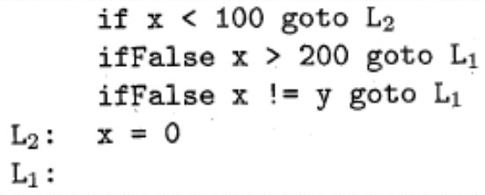
Control flow
Boolean Expressions:
Short-circuit(or jumping ) code:
Intermediate-Code Generation

Slide 33
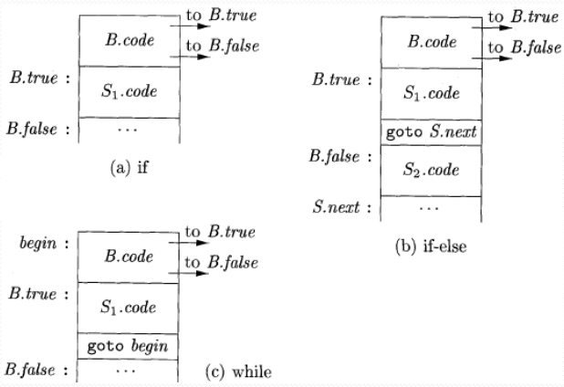
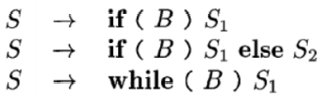
Control flow
Flow-of-Control Statements:
Intermediate-Code Generation

Slide 34
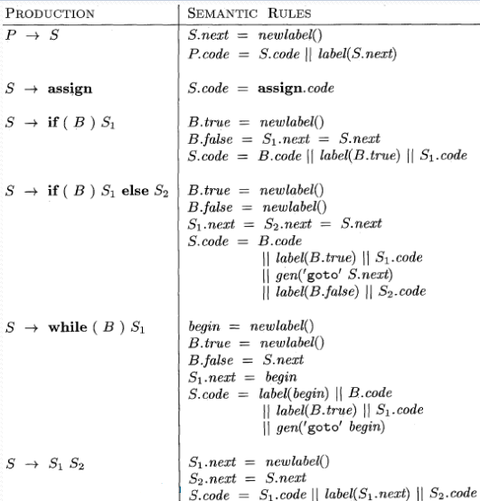
Syntax-directed definition for flow-of-control statements
Intermediate-Code Generation

Slide 35
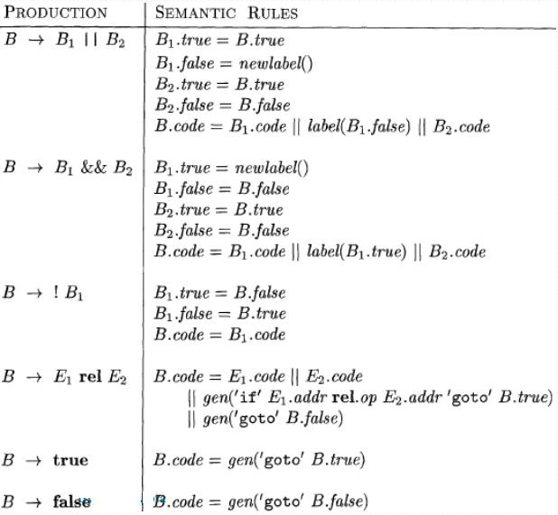
Generating three-address code for booleans

Slide 36
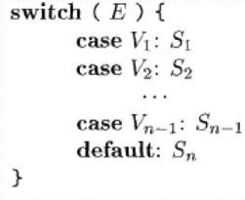
Switch statements
The intended translation of a switch is code to:
1. Evaluate the expression E.
2. Find the value V} in the list of cases that is the same as the value of the expression. Recall that the default value matches the expression if none of the values explicitly mentioned in cases does.
3. Execute the statement Sj associated with the value found.
Intermediate-Code Generation

Slide 37
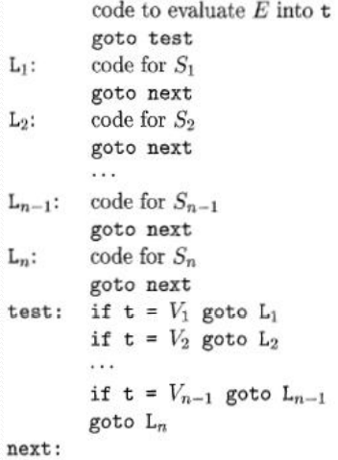
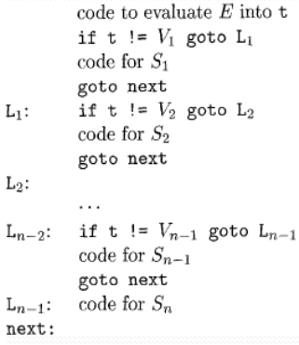
Translation of a switch-statement

Slide 38
THANK
YOU

